Slide 1

Data Scientist BY : HARSHIT GAUR NUID : 001093079

Slide 2
AGENDA
Overview
Data Science Process
USA & Massachusetts Market Analysis
Salary Map in USA
Different Jobs Average Salary Graph
Future Prospect

Slide 3
DEFINITION
Data science is the field of study that combines domain expertise, programming skills, and knowledge of mathematics and statistics to extract meaningful insights from data.

Slide 4

OVERVIEW
Role
Cleans, wrangles, and organizes (big) data
Predicts the results
Mindset
Curious data wizard
Strong business sense
Languages
Python, R, SAS, MATLAB
SQL, Hive, Ping, Spark
Skills & Talents
Modelling
Story-telling & Visualizing
Math, Statistics, Machine Learning

Slide 5
DATA SCIENCE PROCESS
OBTAIN
Gather data from relevant sources
SCRUB
Clean data to formats that machine understand
Extraction, Transformation, Loading (ETL)
EXPLORE
Perform analysis using statistical methods
MODEL
Construct models to predict and forecast
Ex: KNN, Random-Forest Classification, Decision Tree Algorithm
INTERPRET
Put the results into good use
Visualization & Communication

Slide 6
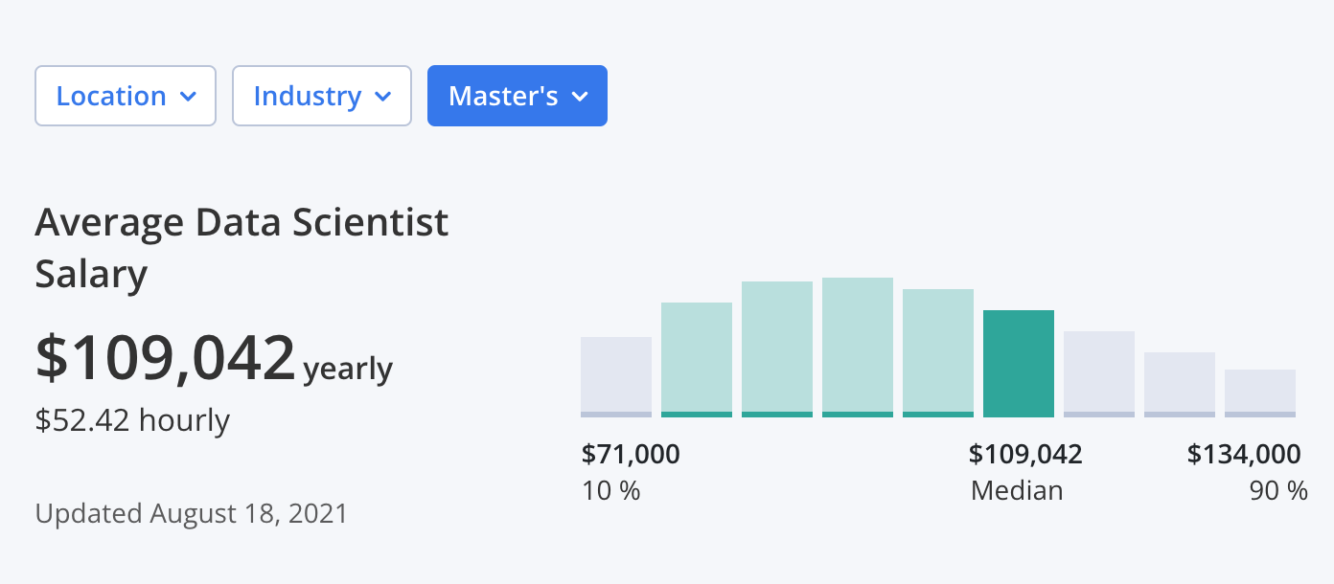
USA MARKET ANALYSIS
The average data scientist salary in the United States for all the relevant industries with Master’s degree is :
$109,042 per year
$52.42 per hour
117,434 jobs are posted for the role of Data Scientist in the US on LinkedIn.
Source : https://www.zippia.com/

Slide 7
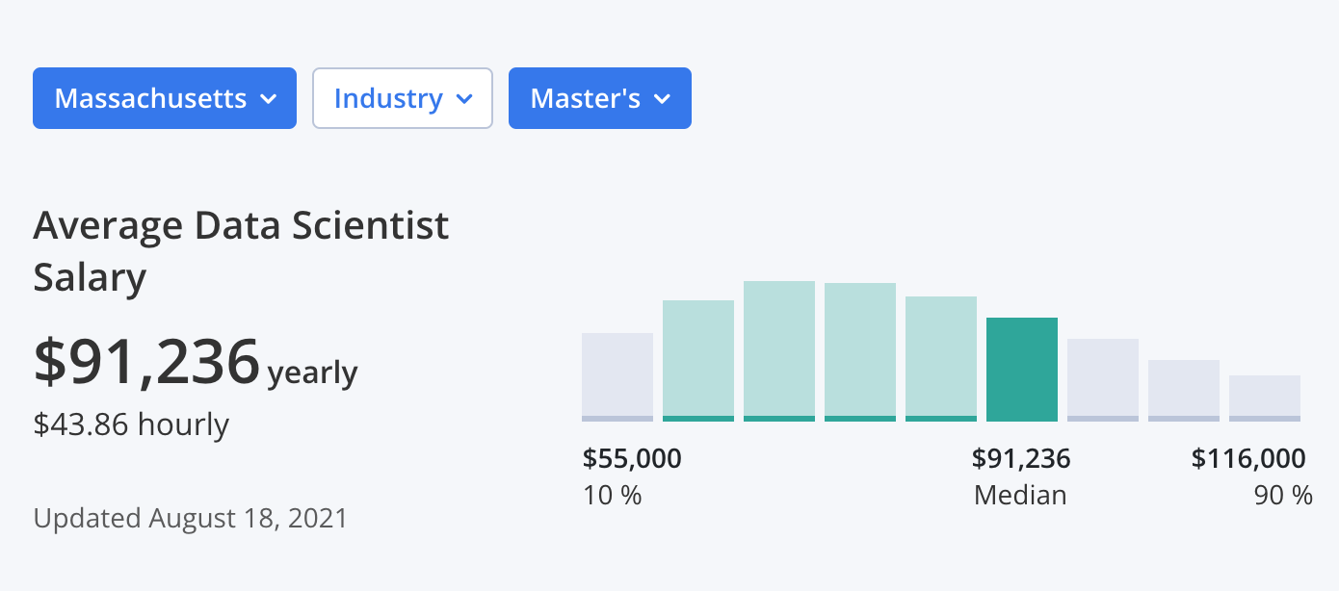
MASSACHUSETTS MARKET ANALYSIS
The average data scientist salary in Massachusetts for all the relevant industries with Master’s degree.
$91,394 per year
$43.94 per hour
The range surrounding that average can vary between $71,000 and $134,000 depending upon the level of jobs.
Source : https://www.zippia.com/

Slide 8
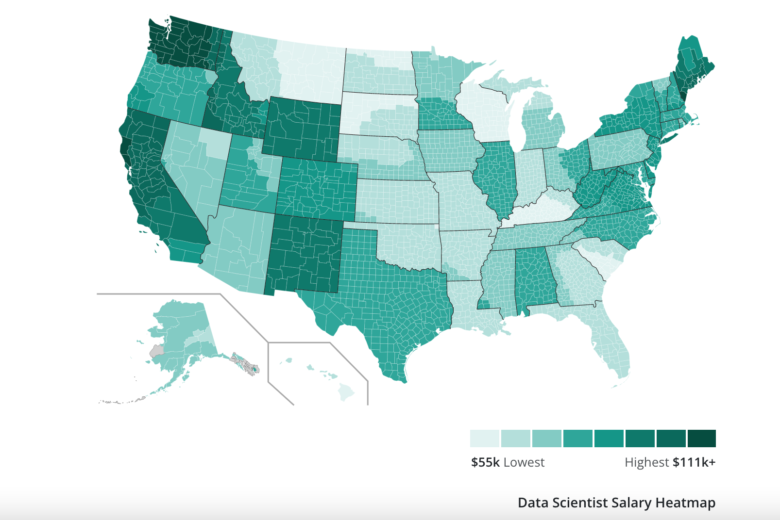
Data Scientist SALARY HEATMAP IN USA
STATE | HIGHEST SALARY | AVG. SALARY
New York | $170,434 | $90,766
Washington | $131,257 | $110,059
Massachusetts | $156,079 | $91,268
California | $146,482 | $95,739
Arizona | $150,440 | $71,997

Slide 9
DIFFERENT JOBS AVERAGE SALARY GRAPH

Slide 10
FUTURE PROSPECT
LinkedIn listed Data Scientist as the #1 job for 4 consecutive years till 2020.
Data has become the backbone of business decision making of organisations.
It has fuelled the demand of Data Scientist and will continue to grow in future as well.

Slide 11
BIOBLIOGRAPHY
I. (2021b, October 20). Infographics : The Different Data Science Roles in The Industry. Imarticus Learning. https://blog.imarticus.org/infographics-the-different-data-science-roles-in-the-industry/
Data Scientist Demographics and Statistics [2021]: Number Of Data Scientists In The US. (2021, September 9). Data Scientist Demographics and Statistics. https://www.zippia.com/data-scientist-jobs/demographics/
5,000+ Data Scientist jobs in Boston, Massachusetts, United States (109 new). (2021, September 21). LinkedIn. Retrieved October 17, 2021, from https://www.linkedin.com/jobs/search/?geoId=102380872&keywords=data%20scientist&location=Boston%2C%20Massachusetts%2C%20United%20States
Data Scientist Salary. (2021, August 18). Data Scientist Salary. https://www.zippia.com/data-scientist-jobs/salary/
2021 Data Scientist Salary in Boston (Updated Daily) | Built In Boston. (2021). Data Scientist in Boston | Built In Boston. https://www.builtinboston.com/salaries/data-analytics/data-scientist/boston

Slide 12

THANK YOU

